Slide 1
Centralized Blockchain
EventStore

Slide 2
Agenda
What is Blockchain?
How does Blockchain work (a, b, c)
What is that?
What customers want

Slide 3
What’s blockchain?
4 characteristics that set blockchain apart
distributed
smart contracts
consensus
immutability
Source: https://www.ibm.com/blogs/cloud-computing/2017/04/11/characteristics-blockchain/

Slide 4
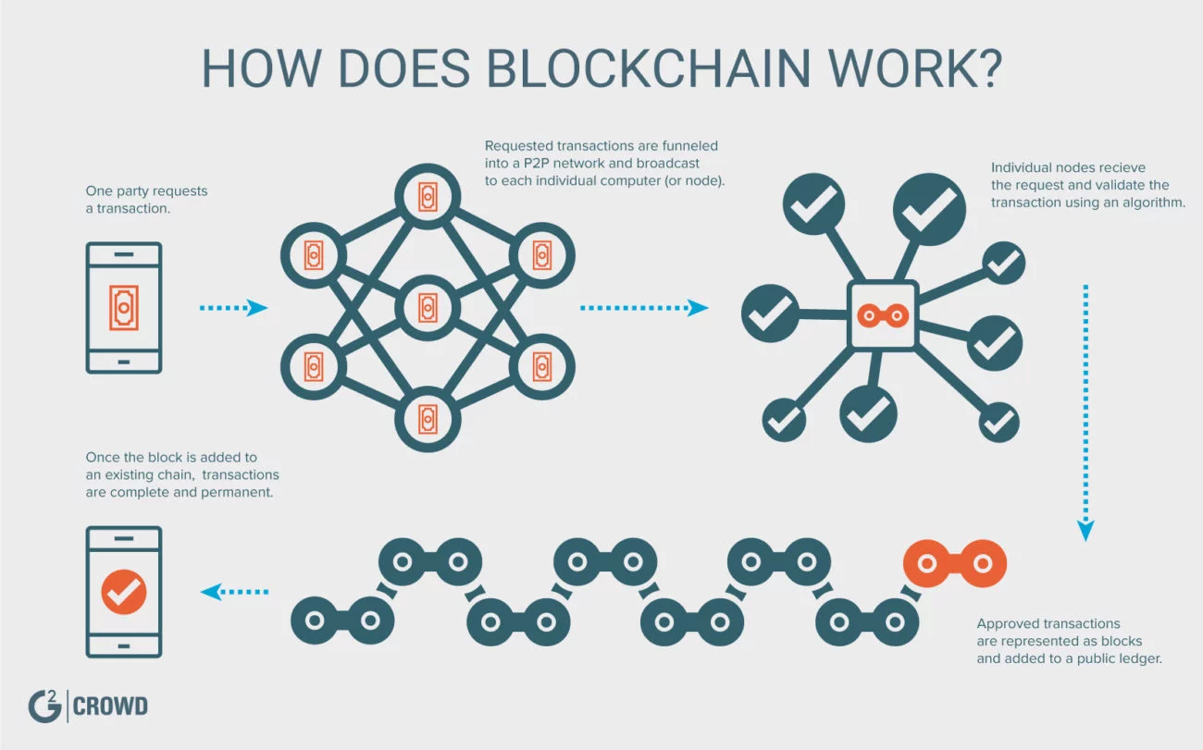

Slide 5
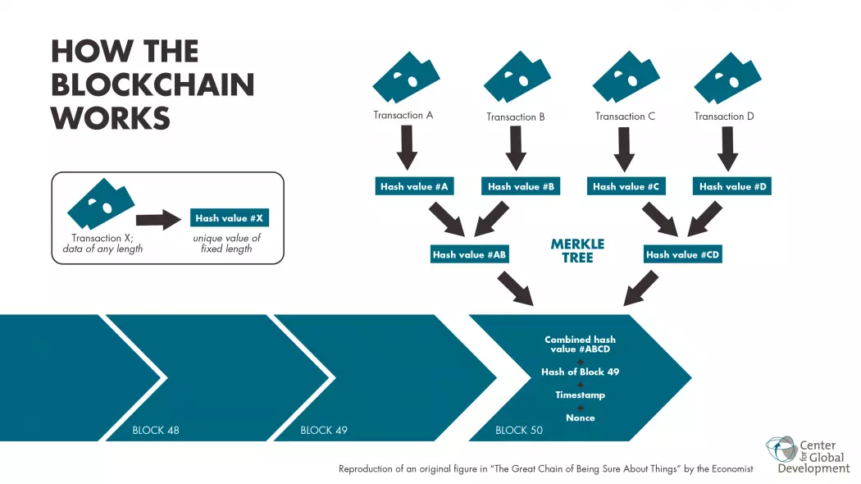

Slide 6
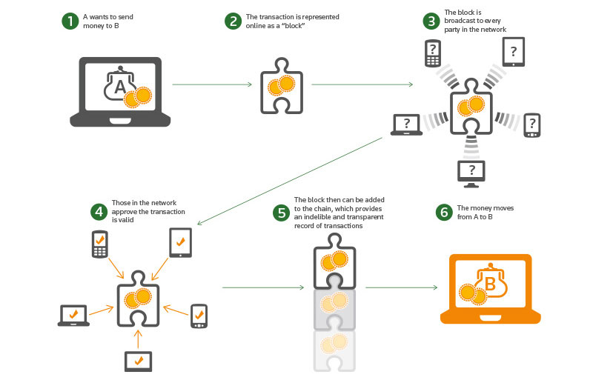

Slide 7
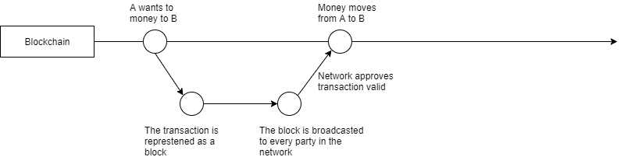

Slide 8
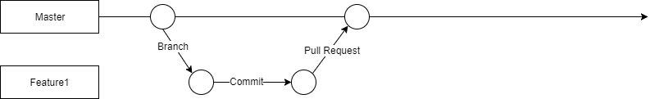

Slide 9
Customer
Want Blockchain!
What for?
Immutability!
Distributed?
No!
Centralized?
Yes!
Here is what you need!

Slide 10
Centralized blockchain
4 characteristics that set blockchain apart
distributed
smart contracts
consensus
immutability
Source: https://www.ibm.com/blogs/cloud-computing/2017/04/11/characteristics-blockchain/

Slide 11
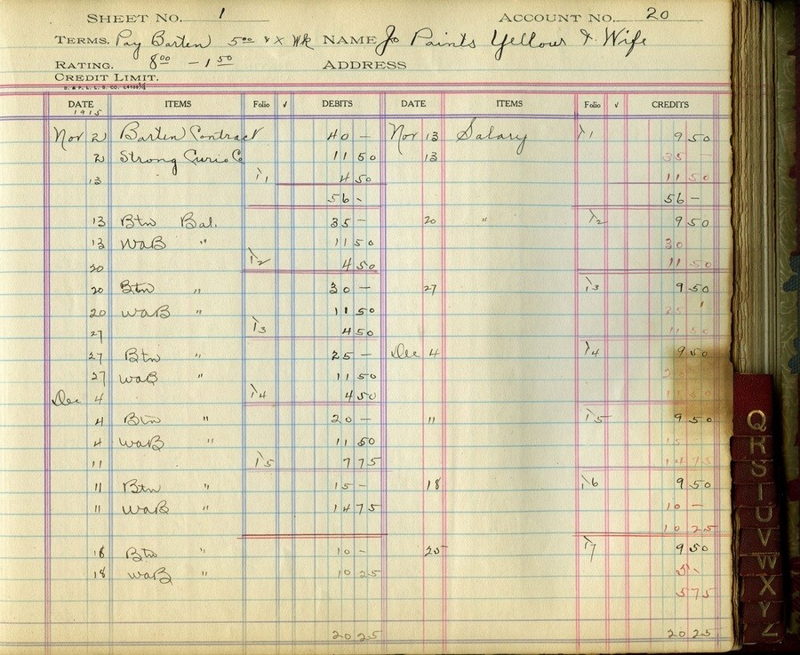
Append Only Ledger

Slide 12
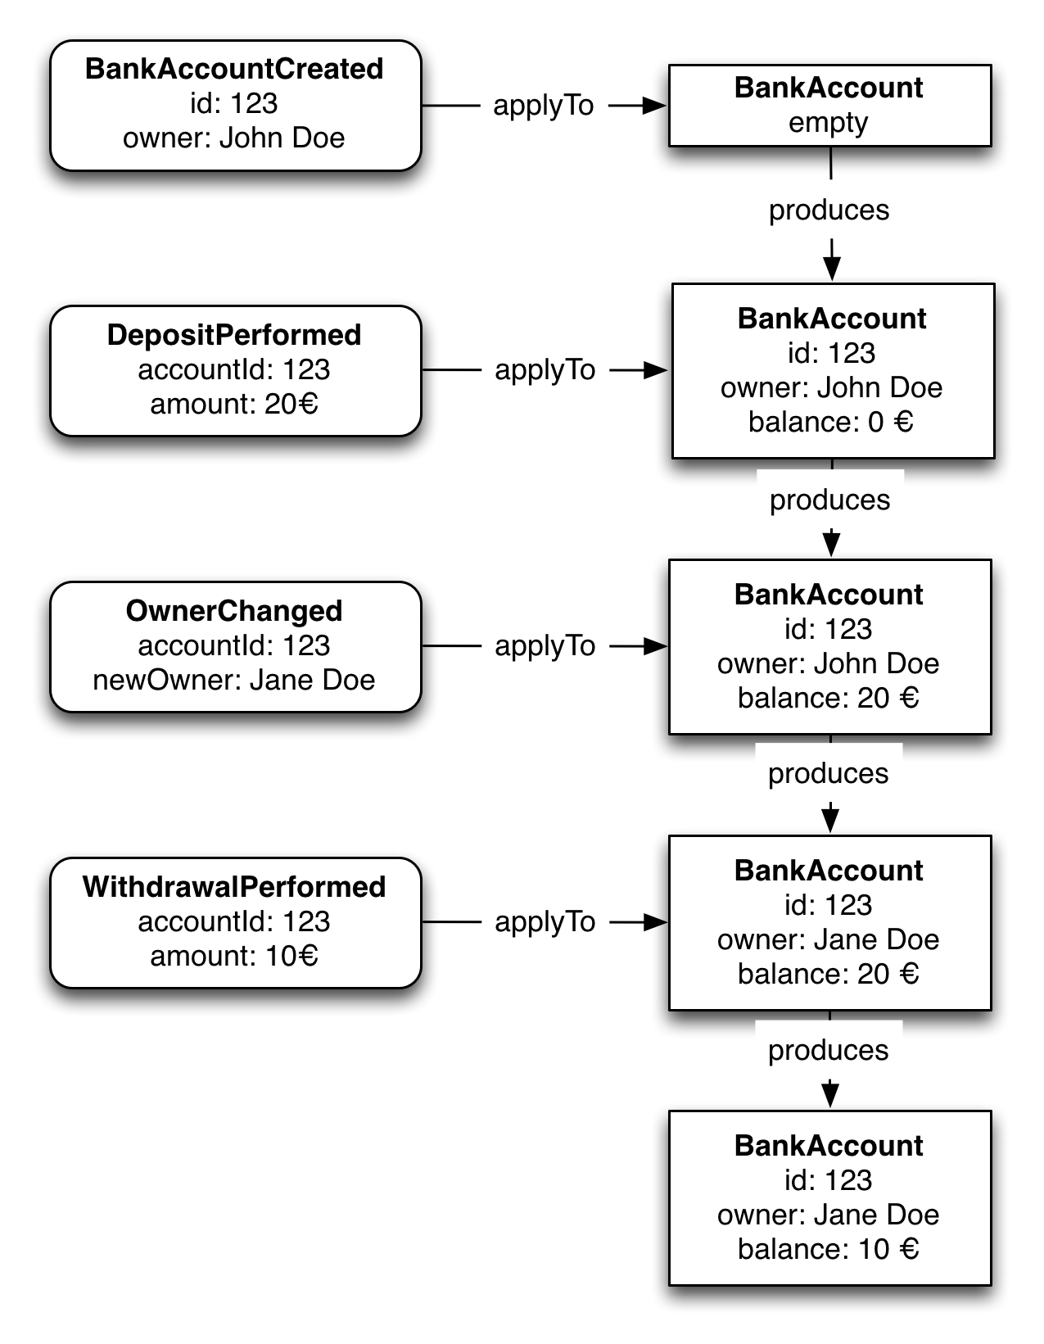
Event Sourcing

Slide 13
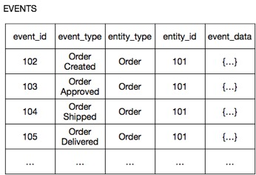
Event Sourcing

Slide 14
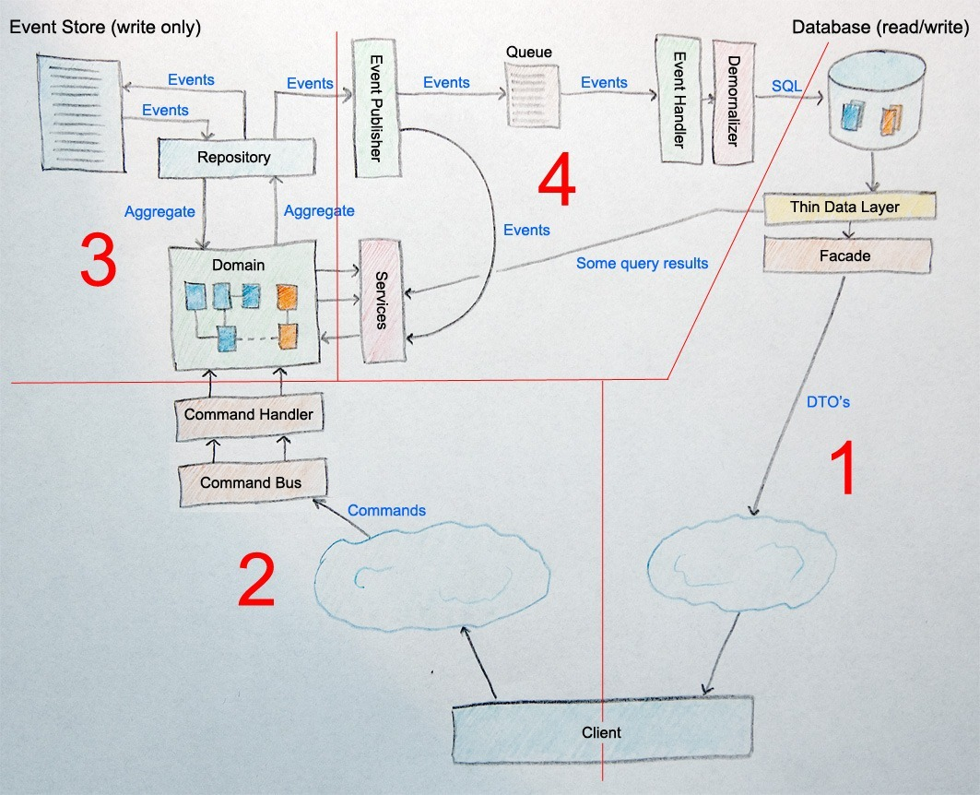
CQRS & Event Sourcing

Slide 15
BUT I WANT CLOUD!

Slide 16
Serverless CQRS

Slide 17
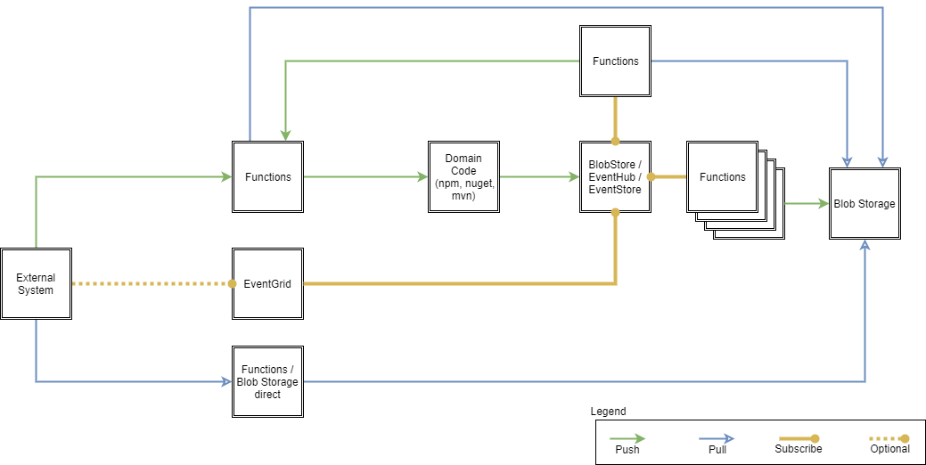
Serverless CQRS

Slide 18
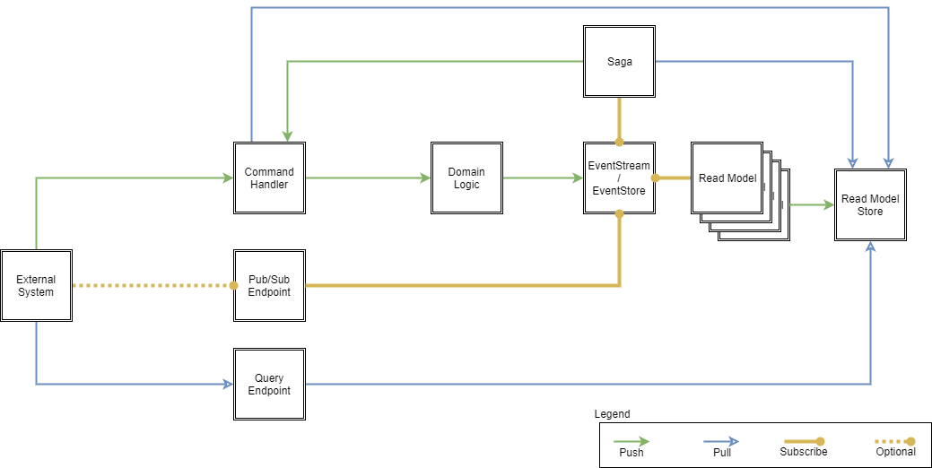
Serverless CQRS

Slide 19
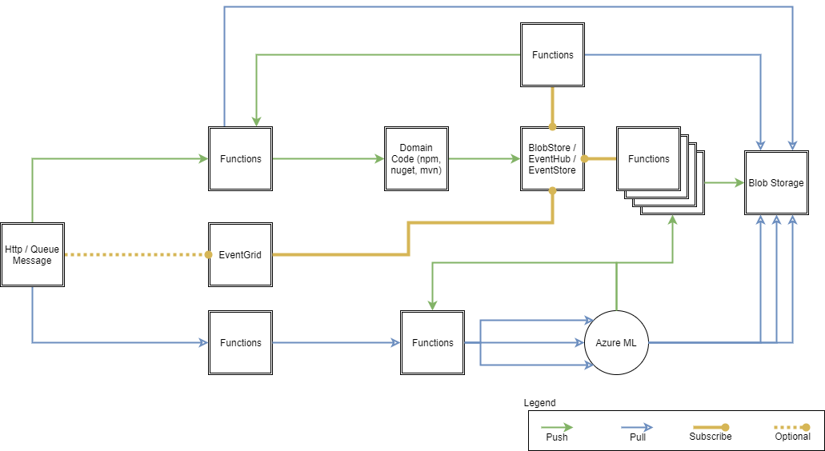
Serverless CQRS - Future

